Slide 1

Ψηφιακή εποχή στην εκπαίδευση: Πως μετράμε την αποτελεσματικότητα στις ψηφιακές εκπαιδευτικές εκδηλώσεις;
Ioannis Androutsopoulos
Omnichannel Manager GSK
NP-GR-NA-PPT-230002
ΙΣΧΥΣ: 6/23 – 6/25

Slide 2
Table of contents
01
02
03
04
05
06
New ‘Era’
Insights
Challenges
Multichannel → Omnichannel
HCPs viewpoint
Future….
Event Metrics vs Event KPIs
Optimization Plan
Pre – During – Post Event

Slide 3

Activation

Slide 4
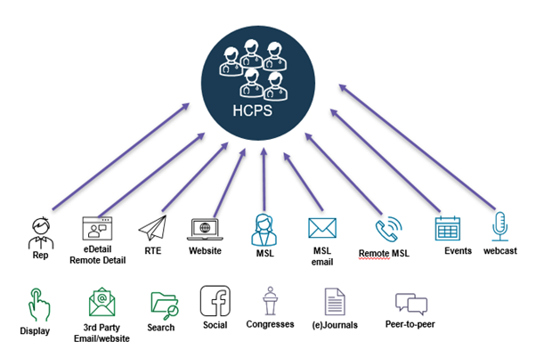
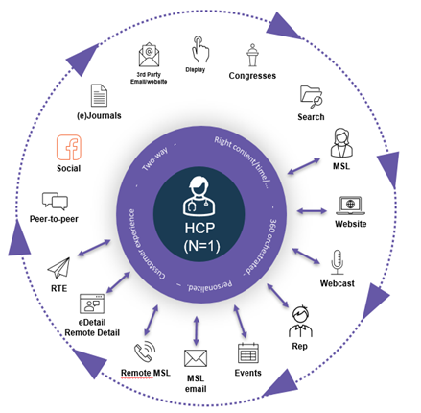
Transformation
Multichannel
Omnichannel
Όλα τα Μηνύματα
Όλα τα Κανάλια
Όλες τις Ώρες
Όλοι οι Ιατροί
Κατάλληλα Μηνύματα
Κατάλληλα Κανάλια
Κατάλληλη Ώρα
Κατάλληλα Ιατροί

Slide 5
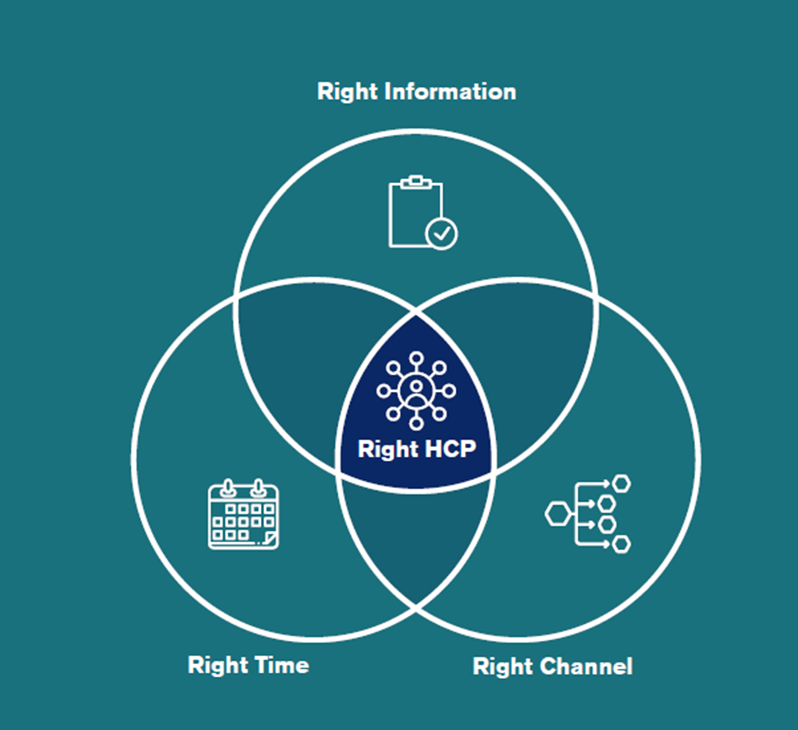

Slide 6
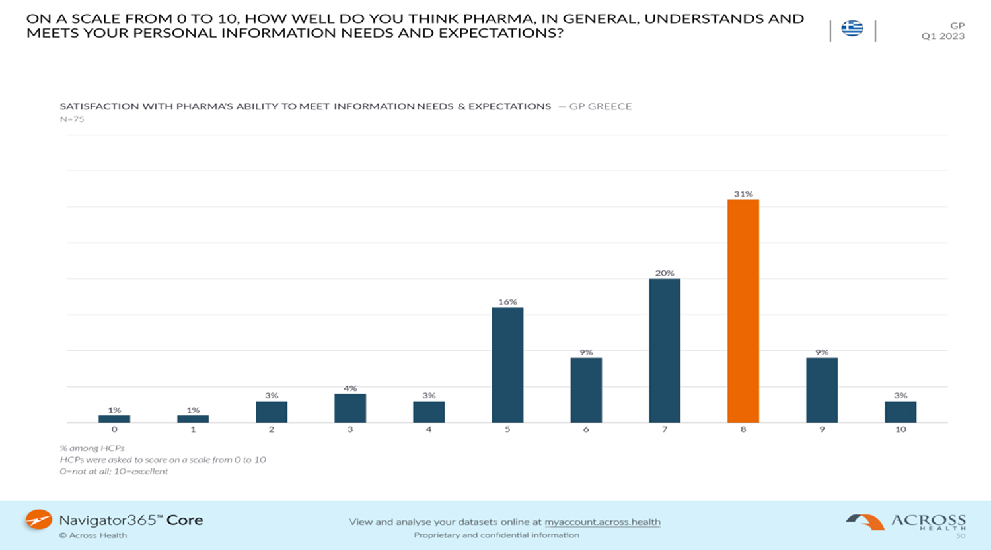

Source: Across Health

Slide 7
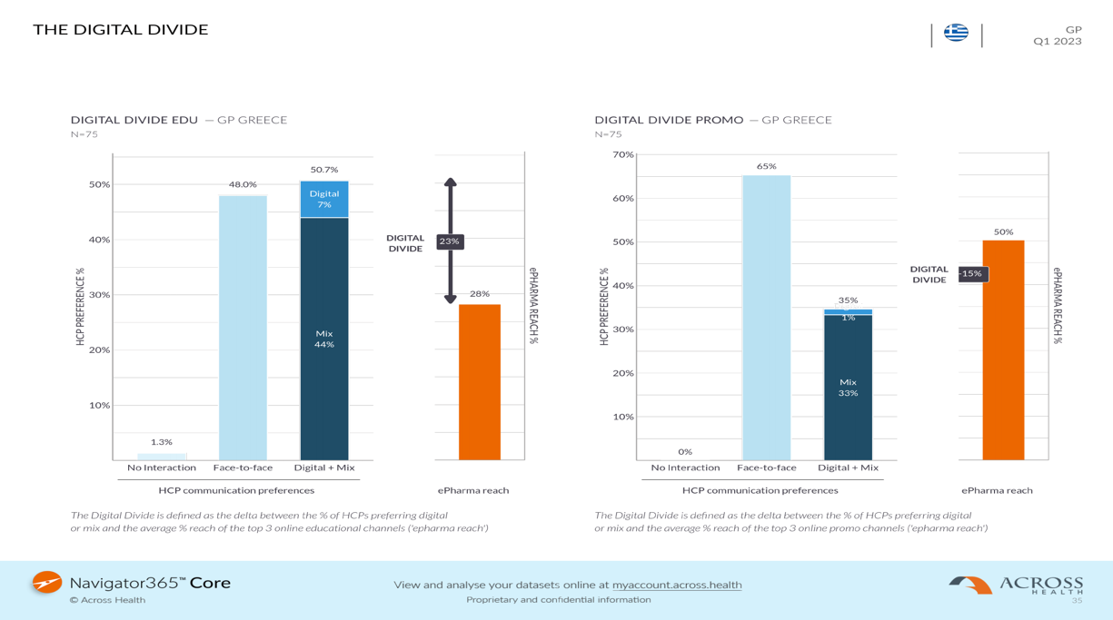
Source: Across Health

Slide 8

Challenges…
How will you understand how your customers engaged with every touchpoint across the omnichannel journey?
How will you build better event engagement in the future to attract more attendees?
How will you define your next best action with customers?
How will you measure the success of your event and show the value events create for your business?

Slide 9

Guiding principles
Omnichannel is part of Brand / Desease Strategy
Optimization Plan
User Journeys / Campaign Objectives
IntergratedPersonas

Slide 10
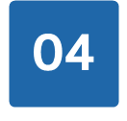



Event metrics vs event KPIs
Event metrics
Event metrics are quantitative measurements that capture various aspects of an event. They provide a snapshot of an event by serving raw data about, for example:
Number of attendees
Number of meetings
On Demand watch time
Number of poll votes
Engagement Score

Slide 11
Event metrics vs event KPIs
Event KPIs
Event KPIs track performance or progress based on your specific event goals. They are strategic indicators that communicate the progress of your event goals. Whereas event metrics track the specific aspects that are working towards those goals.
Event KPIs include:
NPS (Net Promoter Score)
Perception Change
Conversion rate of leads to customers
CSat (Customer Satisfaction Score)

Slide 12
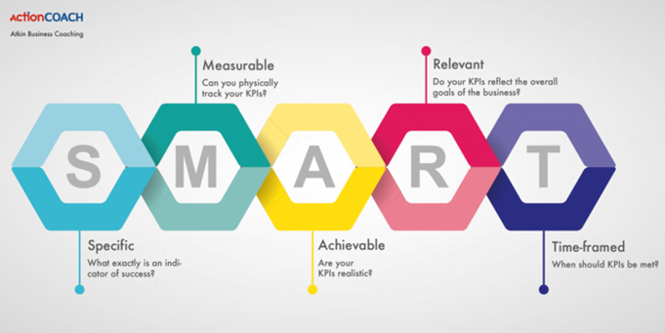
Event metrics vs event KPIs
Effective event KPIs should help your team understand if you’re making the right decisions about your event. They are actionable, directly linked to event success, and guide you towards event outcomes

Slide 13
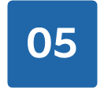
Pre Event
A/B Testing
Setup Web Analytics
Utilize tracking parameters
Number of registrations
Email open and click-through rate (CTR)
Social media engagement (if you use Social Media)

Slide 14
During Event
Event attendance
Returning participants
Engagement rate
  Live polling response rate
  Number of chat messages

Slide 15
Post Event
NPS
Perception Change
Conversion rate of leads to customers
CSat (Customer Satisfaction Score)
Website traffic
NBA (Next Best Action)

Slide 16
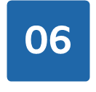


Future OR Present?
AI Analytics
MCQ (Multichannel Equivalent)
What about Patients?
Source: ChatGPT

Slide 17
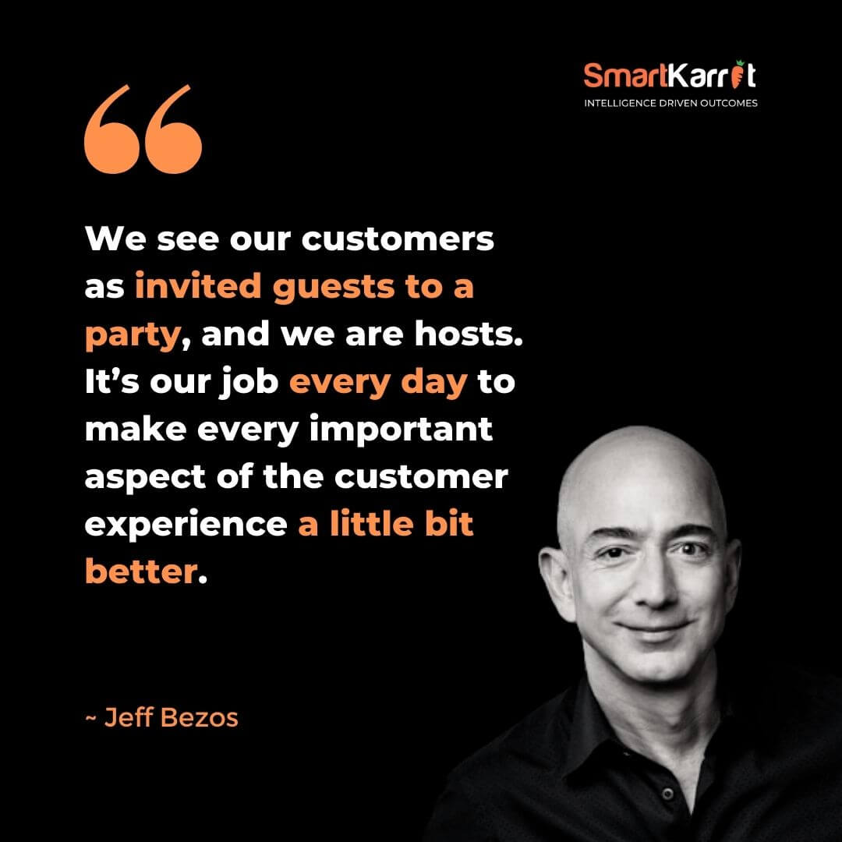

Slide 18

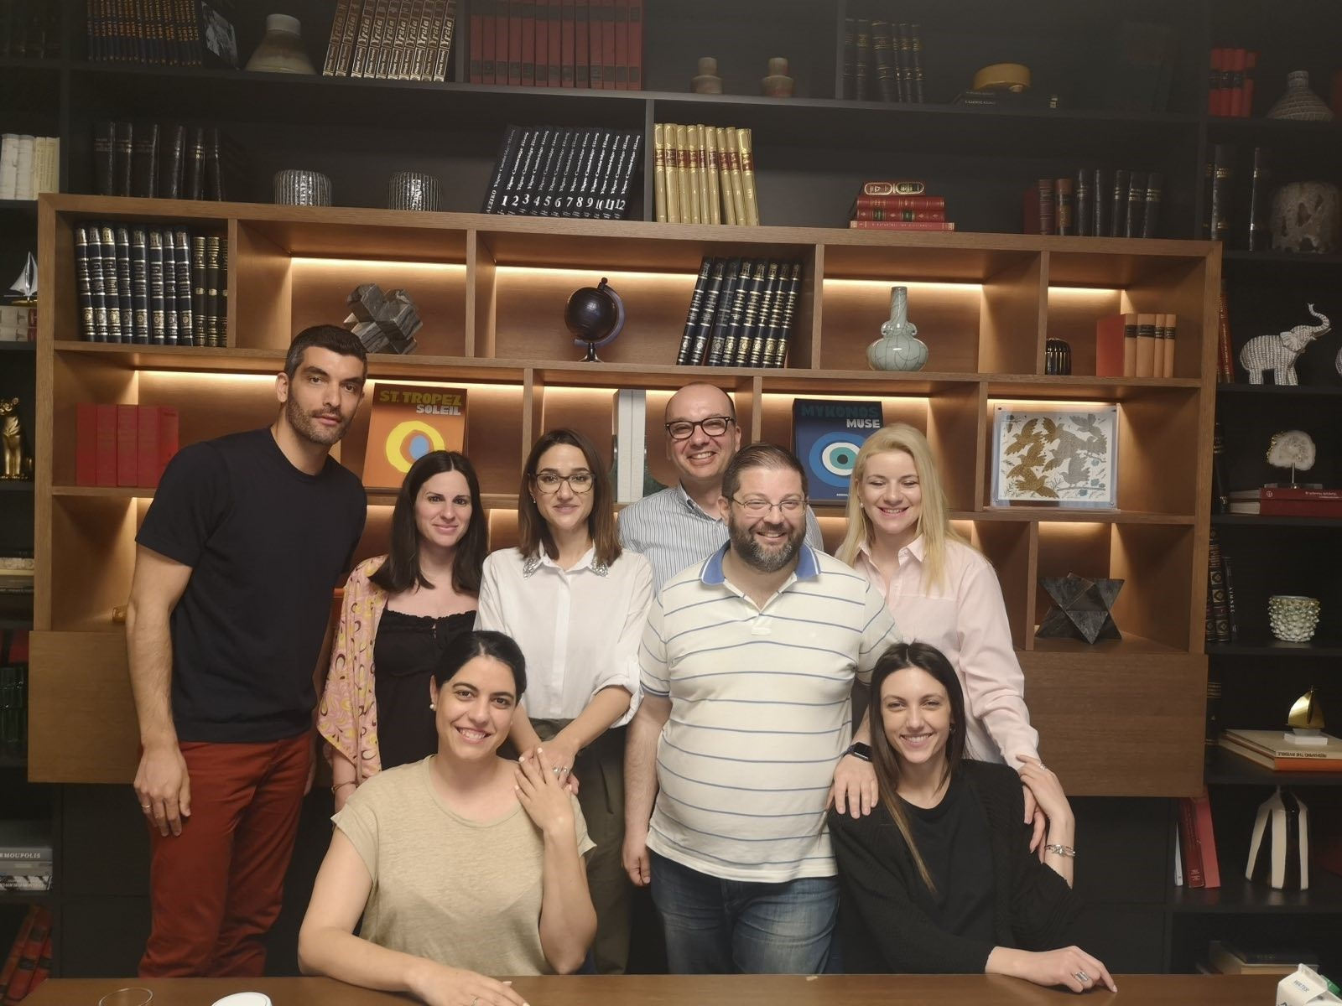
Our team

Slide 19

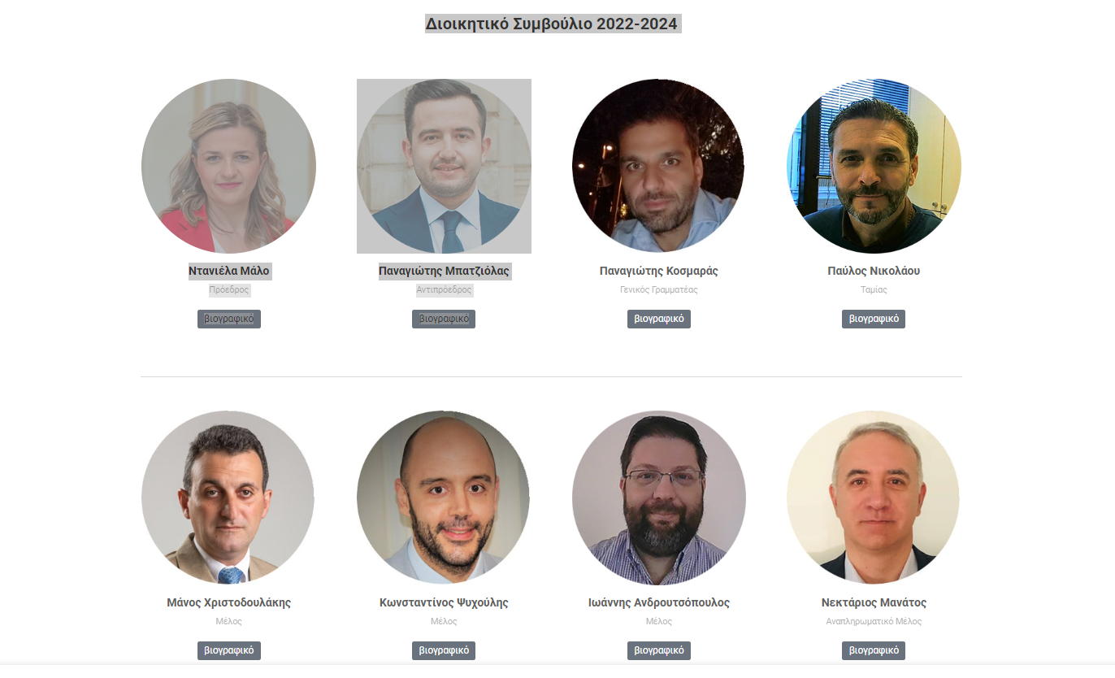
Our team

Slide 20
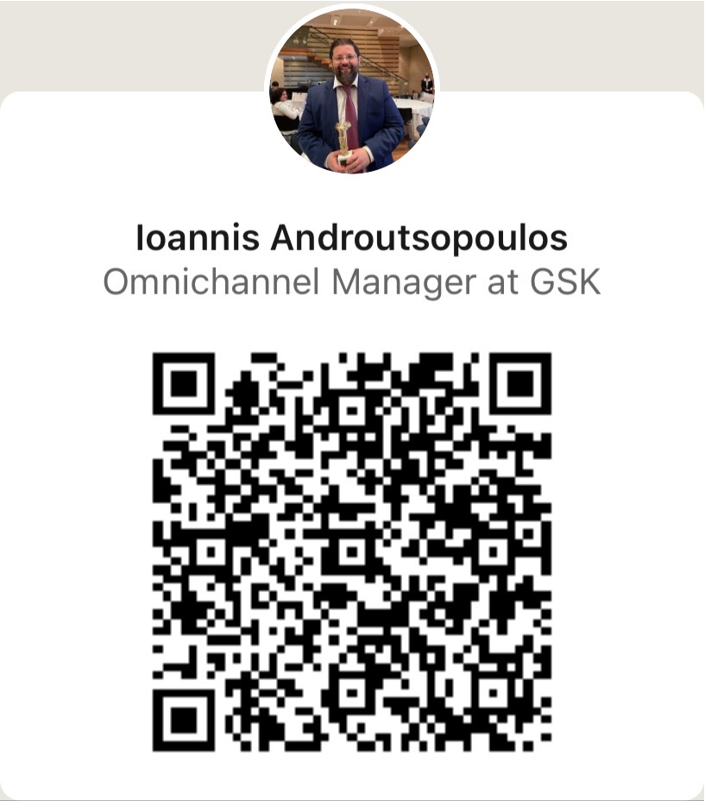
Thanks
Do you have any questions?
Ioannis.p.Androutsopoulos@gsk.com
6942 467199
NP-GR-NA-PPT-230002
ΙΣΧΥΣ: 6/23 – 6/25

